Slide 1
Model for Consistent Process Control
I1
Process Reactor
I2
O1
I3
O2
I4
.
.
.
.
.
.
Goal : To predict I1,I2 for a consistent O1 and variable I3,I4,I5…..
Data : Lab generated data for the input/output space.
E.g of data :Time, Pressure, fluid flow, temperature, power, transient time,
output1/output2 electrical power, thermal energy, rate of formation,....
This will be solo project

Slide 2
Data Analysis and Machine Learning
DATA :
Data will be generated on proprietary machine and uploaded to postgres.
Data includes all input/output parameters including machine ID.
Questions :
Can a ML algorithm predict two input variables for a consistent output parameter.? All other inputs can vary.
Use train/test data to validate model
Use the model to predict these key parameters for varying inputs and validate on the machine.

Slide 3
Project Implementation Plan
NOTE : This will be solo project, due to confidentiality of the project/data .
Communication Protocol : As this is a solo project, the code/project management will be through GitHub . The repository will have a single branch for the weekly updates/merge to master as needed.
Data Tools : Jupyter Notebook, Postgres, Visual Code, GitHub,Tableau for dashboard , ployly for final results
Machine Learning : TensorFlow 2
Model : Neural Network - probably 2 hidden layers
Data : From proprietary source covering input / output domain .

Slide 4
Machine Model
INPUT
Hidden Layers
OUTPUT
I3
I4
I5
I6
I7
O1
O2
NN = 5,10,15
…….
NN = 5,10,15
I1
I2
Optimizer = SGD/adam, loss = mse.

Slide 5
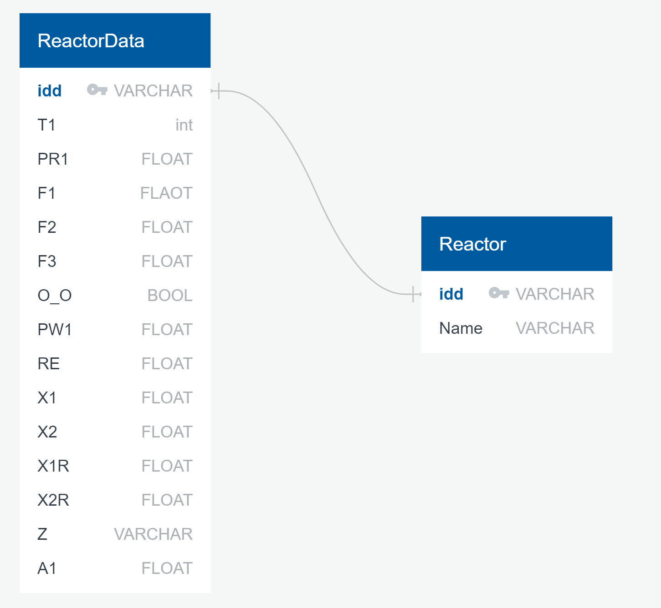
ERD

Slide 6
Data Processing
1) Process Time to be extracted from Data table with pandas
2) Conditions include relationship between columns to achieve steady state to extract transition time
Diff() - see run transitions
Conditional column comparisons to extract transition time for each run
3) Set up tensor flow with input and output parameters
Model Input : flows, pressure, power, time
Model Output : input param1, input param2
4) Use NN with adam optimizer ( similar to SGD). Save the model
5) Use Model saved for predicting input param1, input param2 for a trial run
6) Test on tool and measure actual time via (1-2) above
7) Plot actual time vs Predicted time . Compute R Value. For production solution need RValue > 0.9

Slide 7
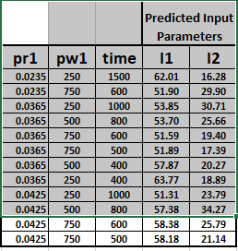
Predict Input Parameters (I1/I2)

Slide 8
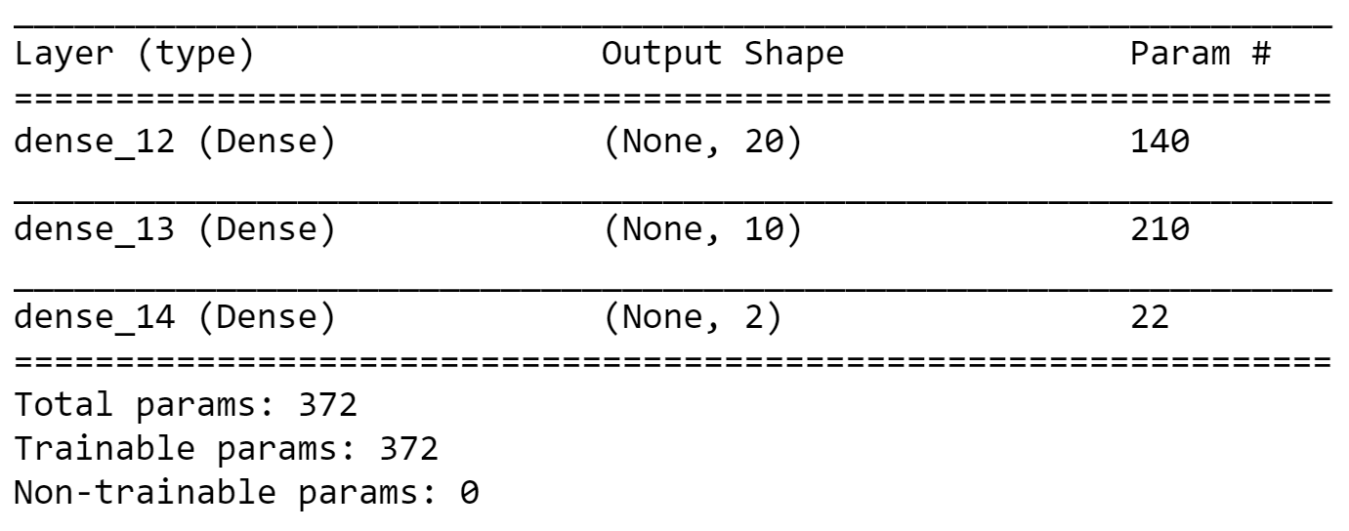
Analysis : Model
Model : 2 hidden layers. 20/10 neurons , activation for both ‘relu’
Input : 6 params
Output : 2 params, no activation
Model Compile : loss='mse', optimizer="adam",metrics=["mse"]

Slide 9
Neural Network Model Fit - Results
len(X_train) : 626, len(X_Test) : 209
batch_size= 50,epochs=30
RUN RESULTS
7/7 - 0s - loss: 0.0141 - mse: 0.0141
Loss: 0.01408314611762762
Model saved to be used on the tool for prediction of 2 input parameters before running the tool.

Slide 10
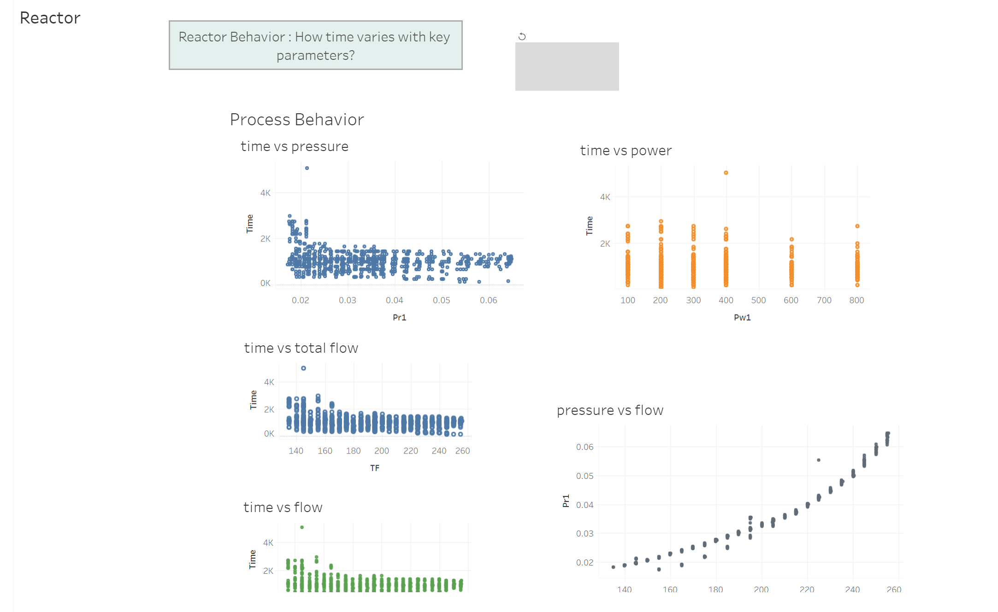
DASHBOARD
DASHBOARD

Slide 11
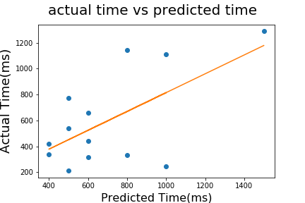
Results (real run)
Slope = 0.72 Intercept = 86.51 Rvalue = 0.62 P Value = 0.024 StdErr = 0.28
Plotly Link
Model needs to be refined to achieve R value > 0.9 . R value with this model 0.62
Next Steps : a) Eliminate overlapping input parameters. (e.g flow and pressure)
b) Set boundary conditions for power and pressure

